Slide 1
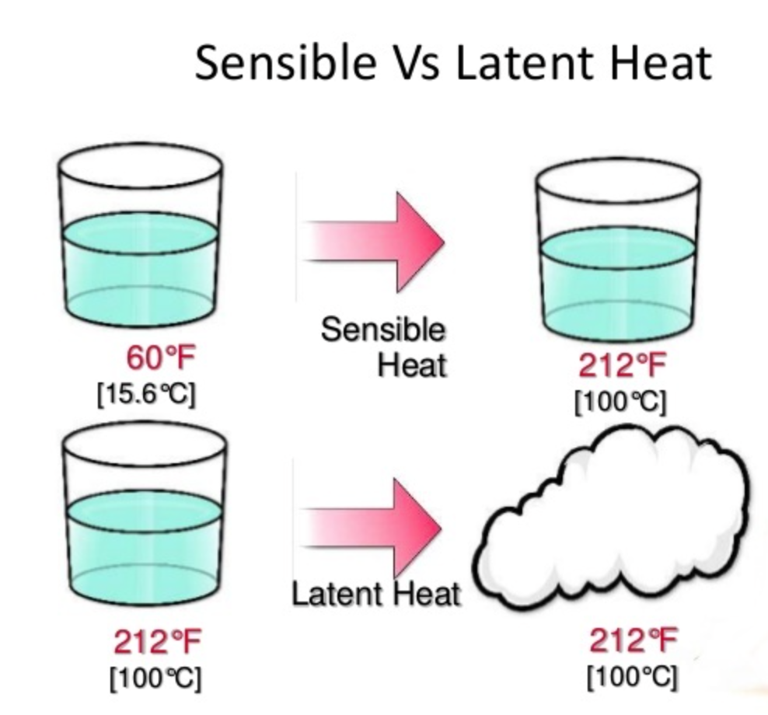
Chemical Engineering Thermodynamics Lecture 3 Heat Effects; The 2nd Law Xiaofei Xu

Slide 2
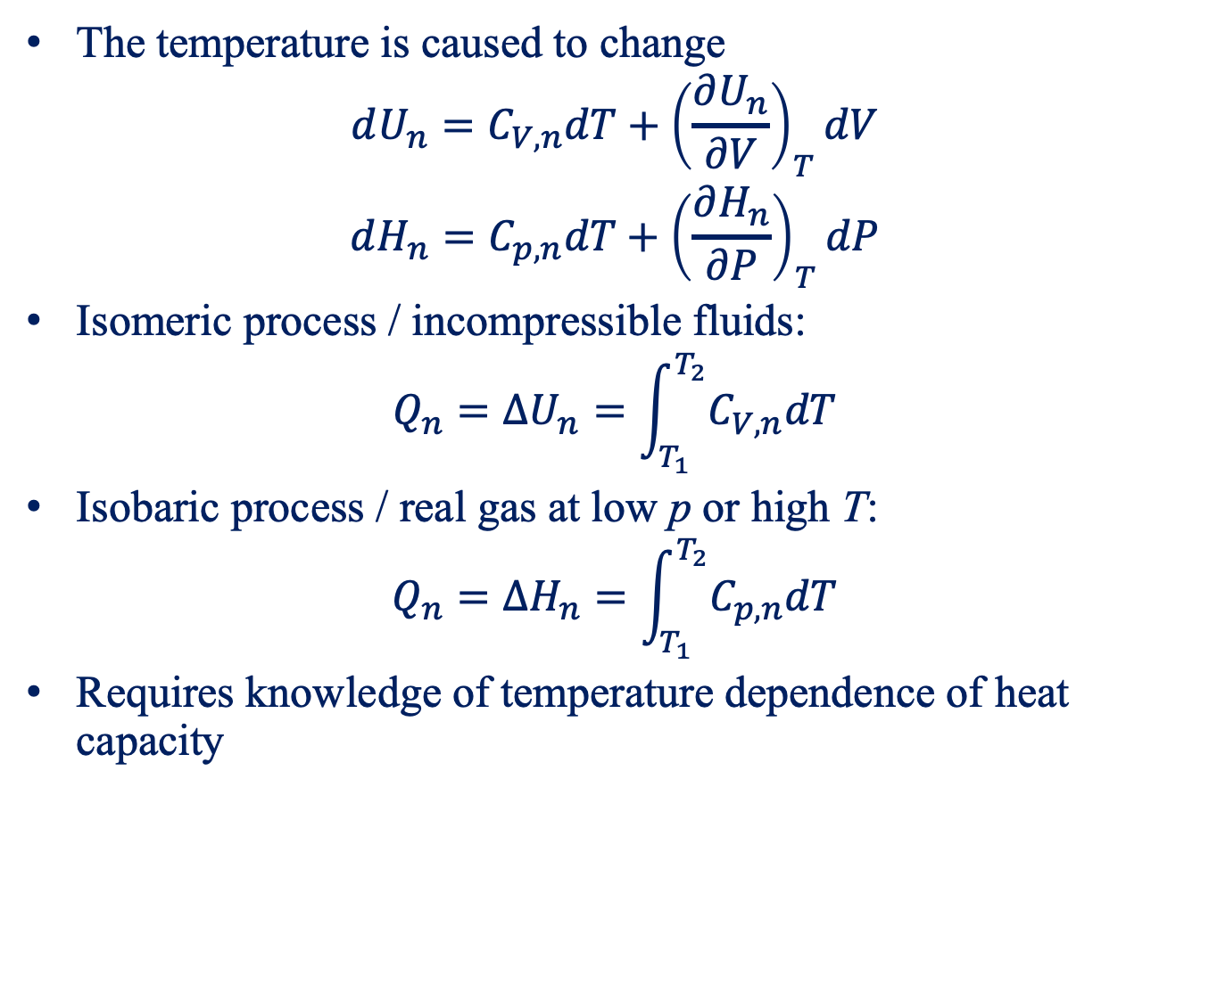
Sensible Heat Effects
The temperature is caused to change
$$dU_{n}=C_{V,n}dT+{\left(\frac{∂U_{n}}{∂V}\right)}_{T}dV$$
$$dH_{n}=C_{p,n}dT+{\left(\frac{∂H_{n}}{∂P}\right)}_{T}dP$$
Isomeric process / incompressible fluids:
$$Q_{n}=ΔU_{n}=\int_{T_{1}}^{T_{2}}{C_{V,n}dT}$$
Isobaric process / real gas at low p or high T:
$$Q_{n}=ΔH_{n}=\int_{T_{1}}^{T_{2}}{C_{p,n}dT}$$
Requires knowledge of temperature dependence of heat capacity

Slide 3
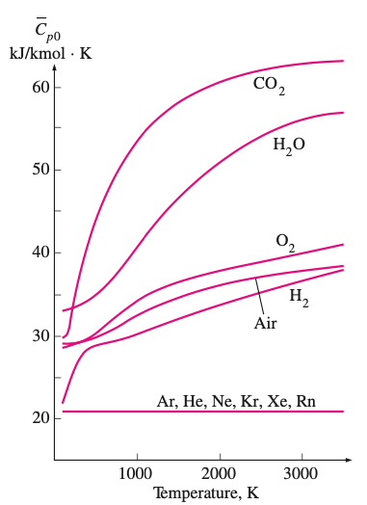
Ideal-gas heat capacity
Real gases at low pressure

Slide 4
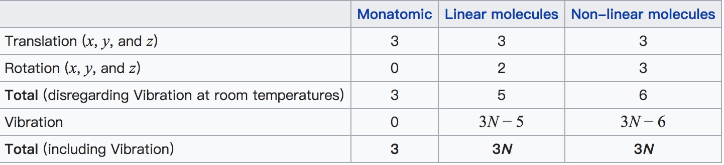
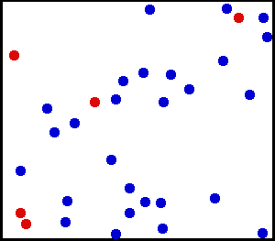
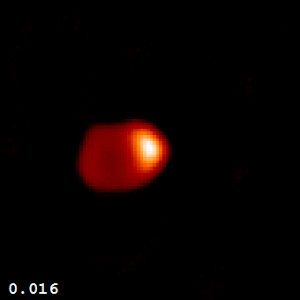
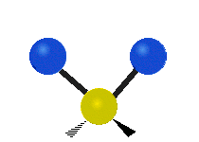
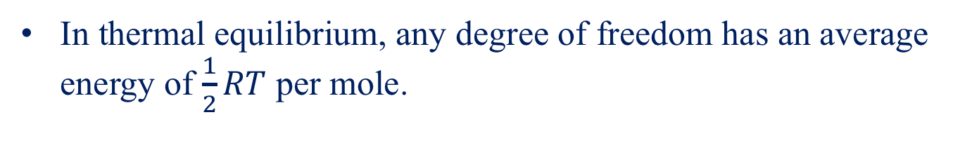
Equipartition Theorem
In thermal equilibrium, any degree of freedom has an average energy of $\frac{1}{2}RT$ per mole.
translation
rotation
vibration

Slide 5
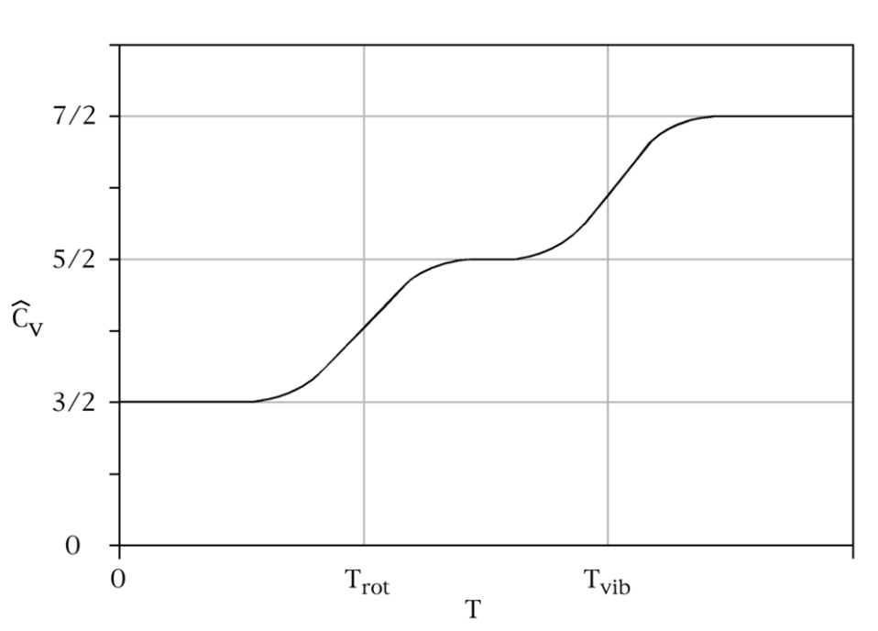
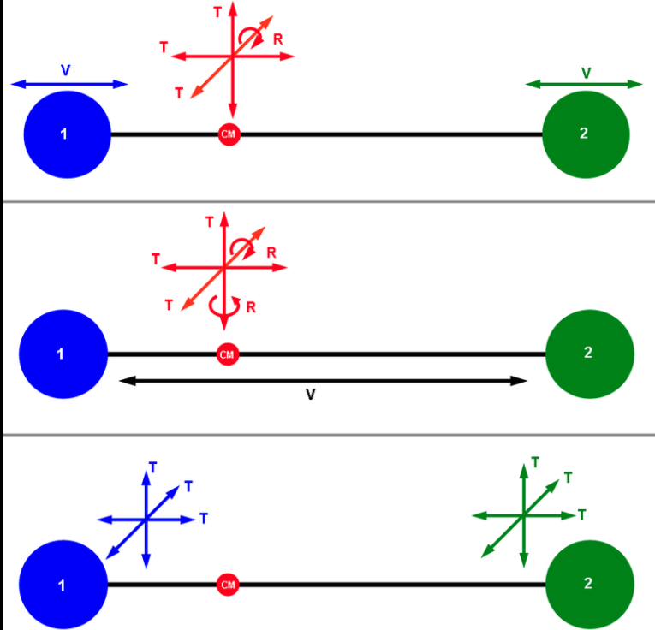
Equipartition Theorem
Molar heat capacity of diatomic gases

Slide 6
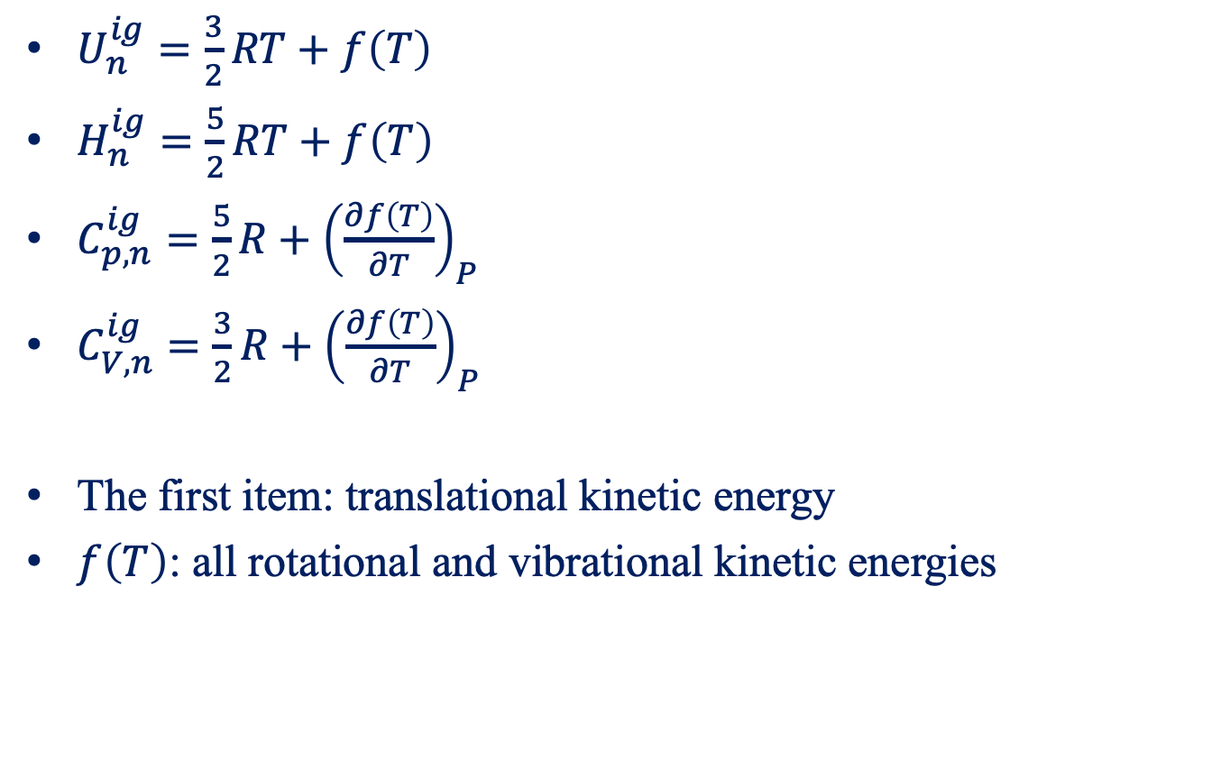
Heat Capacity in the Ideal-Gas State
$U_{n}^{ig}=\frac{3}{2}RT+f\left(T\right)$
$H_{n}^{ig}=\frac{5}{2}RT+f\left(T\right)$
$C_{p,n}^{ig}=\frac{5}{2}R+{\left(\frac{∂f\left(T\right)}{∂T}\right)}_{P}$
$C_{V,n}^{ig}=\frac{3}{2}R+{\left(\frac{∂f\left(T\right)}{∂T}\right)}_{P}$
The first item: translational kinetic energy
$f\left(T\right)$: all rotational and vibrational kinetic energies

Slide 7
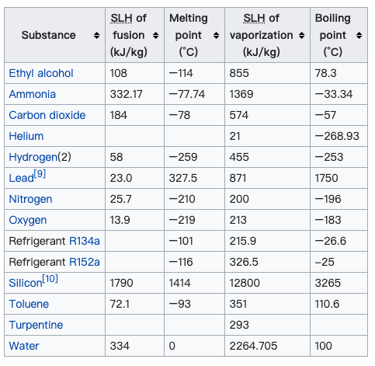
Latent Heat
Heat transfer during phase transition
No change in temperature

Slide 8
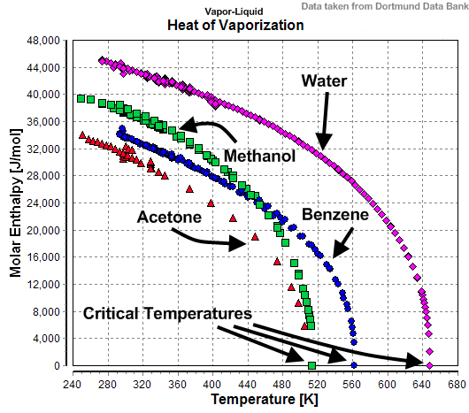
Temperature Dependence of Latent Heat
Decreases with increasing temperature
Falls to zero at the critical point

Slide 9
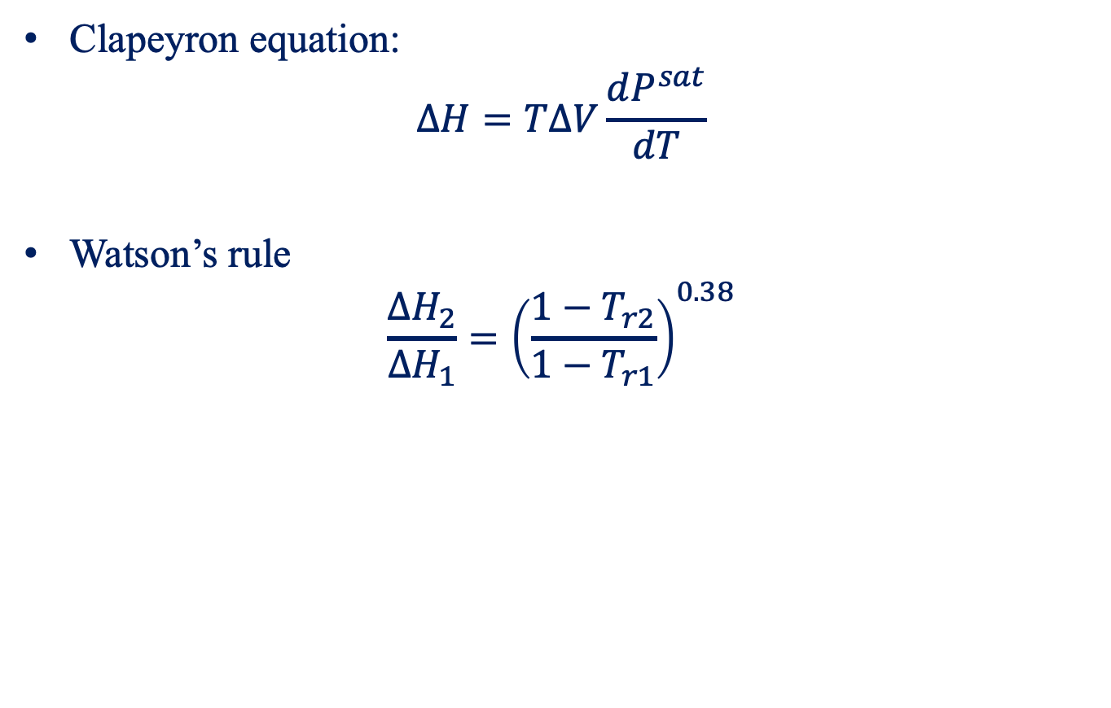
Clapeyron Equation
Clapeyron equation:
$$ΔH=TΔV\frac{dP^{sat}}{dT}$$
Watson’s rule
$$\frac{ΔH_{2}}{ΔH_{1}}={\left(\frac{{1−T}_{r2}}{1−T_{r1}}\right)}^{0.38}$$

Slide 10
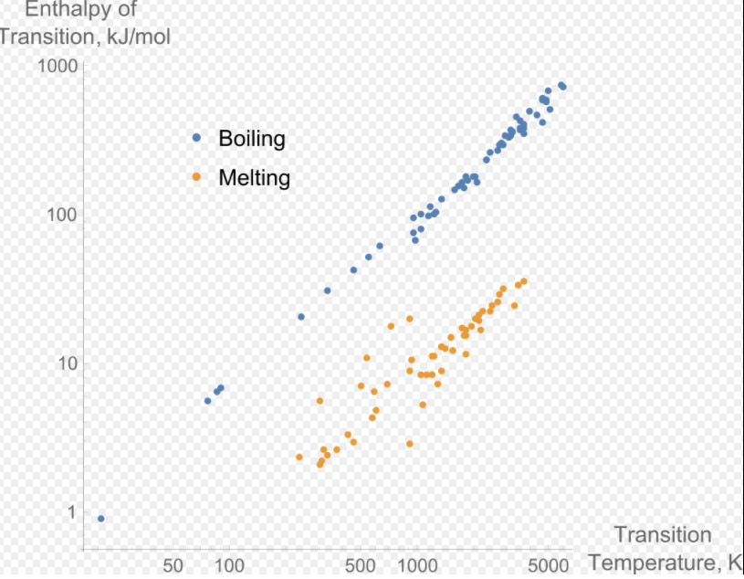
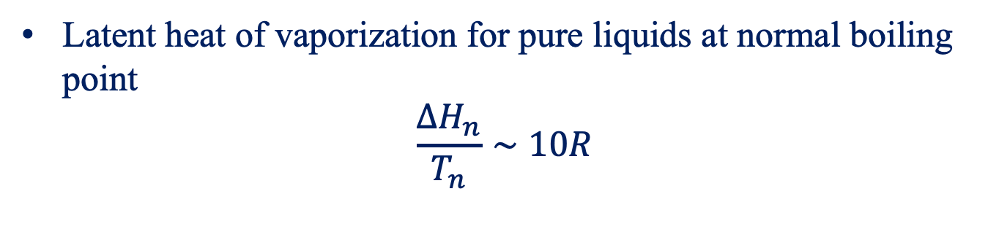
Trouton’s Rule
Latent heat of vaporization for pure liquids at normal boiling point
$$\frac{ΔH_{n}}{T_{n}}∼10R$$

Slide 11
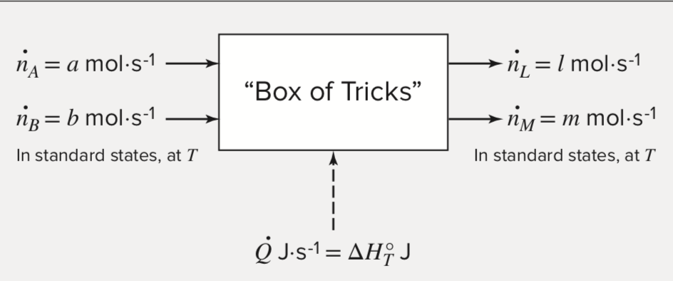
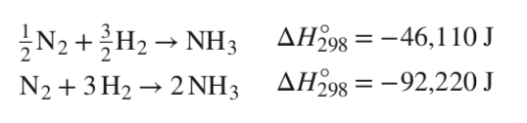

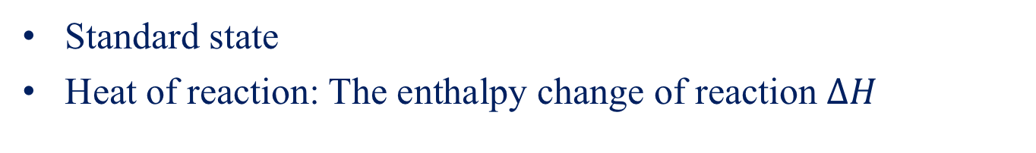
Standard Heat of Reaction
Standard state
Heat of reaction: The enthalpy change of reaction $ΔH$
$$aA+bB→lL+mM$$

Slide 12
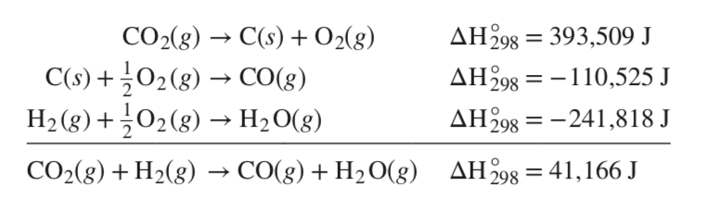
Standard Heat of Formation
Formation reaction
A reaction that forms a single compound from its constituent elements
Formation reactions may be combined to produce any desired reaction

Slide 13
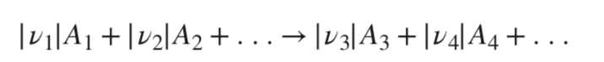
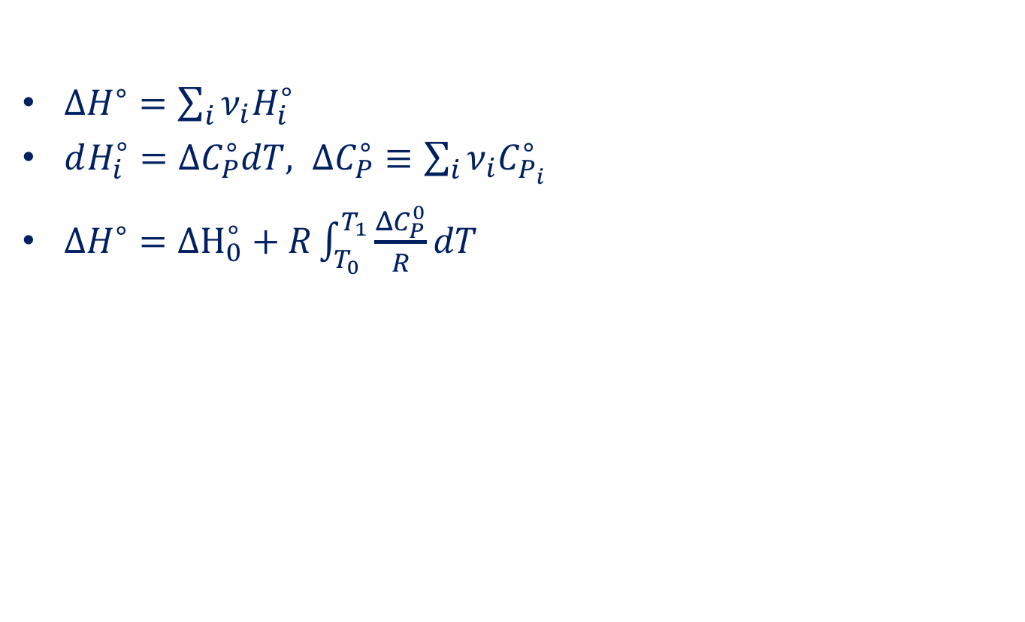

Temperature Dependence of $ΔH^{∘}$
$ΔH^{∘}=\sum_{i}{ν_{i}H_{i}^{∘}}$
$dH_{i}^{∘}=ΔC_{P}^{∘}dT, ΔC_{P}^{∘}≡\sum_{i}{ν_{i}C_{P_{i}}^{∘}}$
$ΔH^{∘}=ΔH_{0}^{∘}+R\int_{T_{0}}^{T_{1}}{\frac{ΔC_{P}^{0}}{R}dT}$

Slide 14
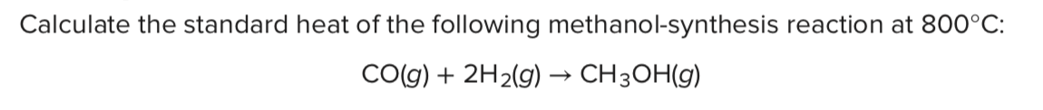
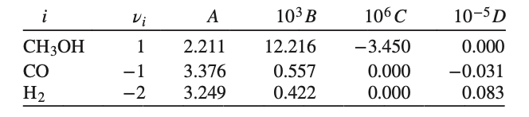
Example

Slide 15
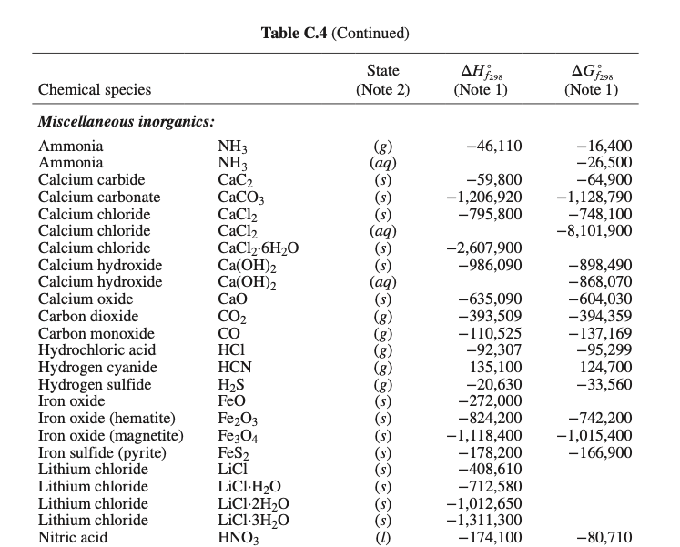

Slide 16
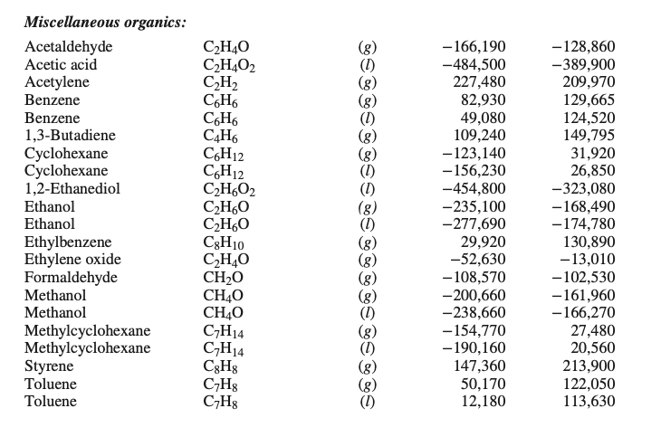

Slide 17
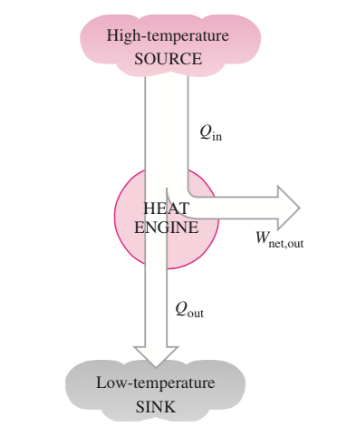
Heat Engines
A device that converts heat or thermal energy into mechanical energy

Slide 18
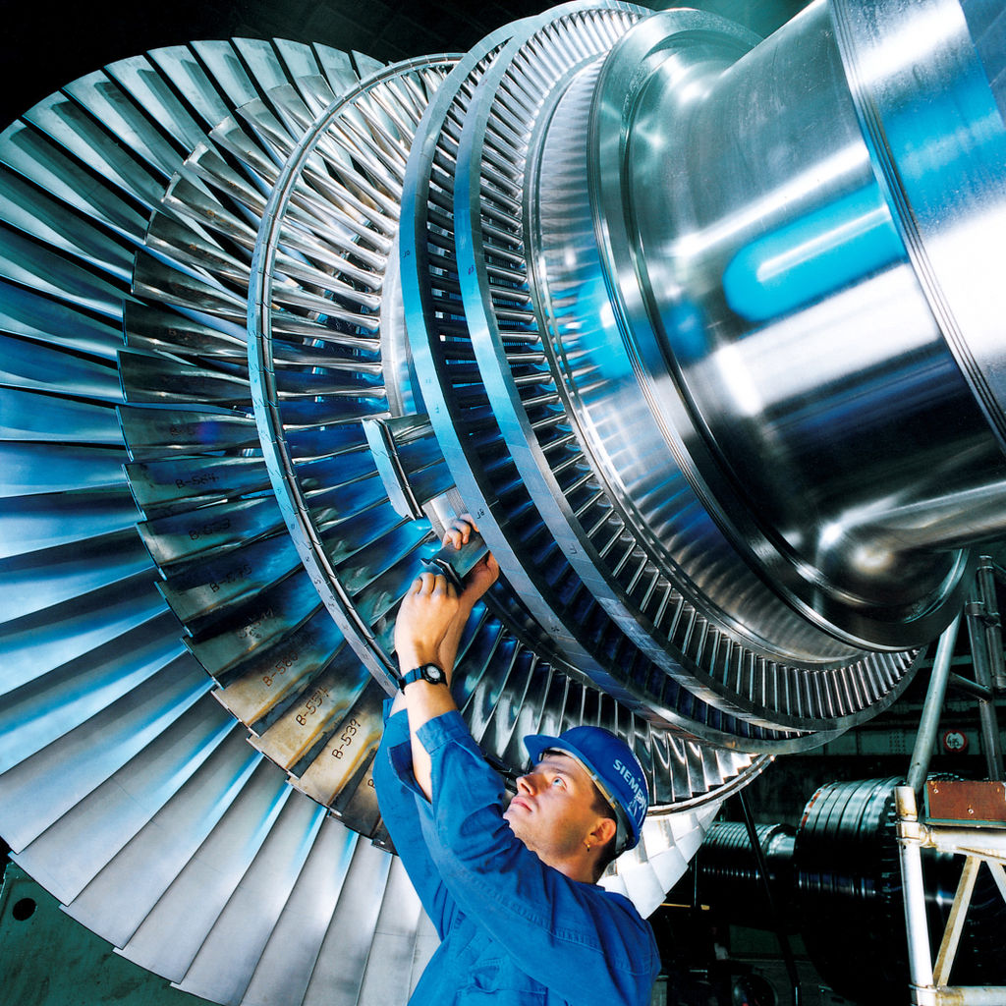
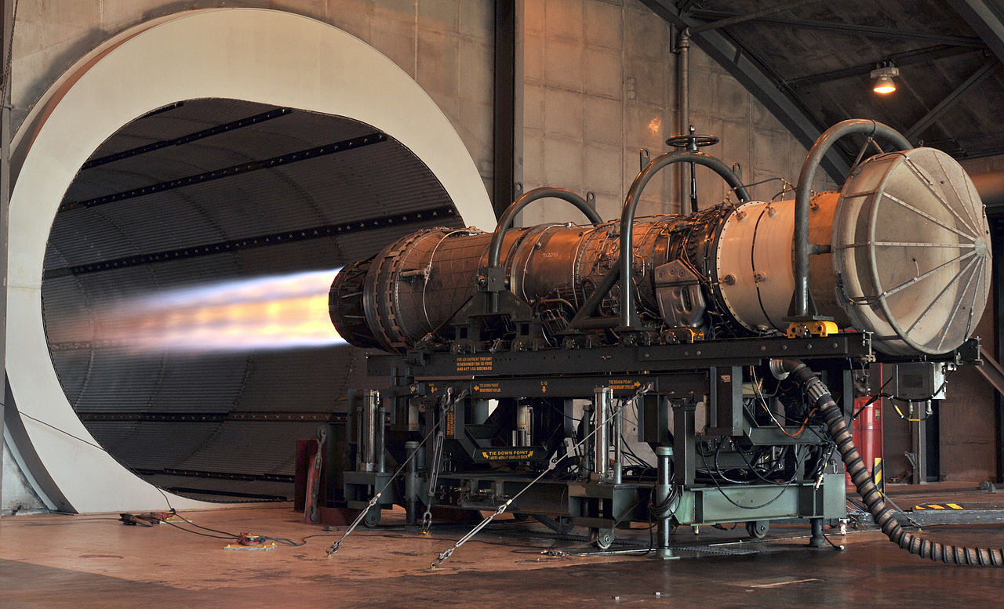
Heat Engines
Steam engine, steam turbine, gas turbine, internal combustion engine, jet engine

Slide 19
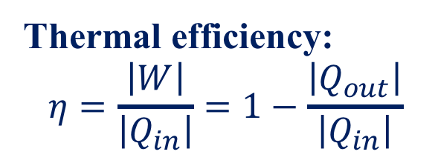
Heat Engines
Receive heat from a high-temperature source
Convert part of the heat to work
Reject the remaining waste heat to a low-temperature sink
Cycle
Thermal efficiency:
$$η=\frac{\left|W\right|}{\left|Q_{in}\right|}=1−\frac{\left|Q_{out}\right|}{\left|Q_{in}\right|}$$

Slide 20
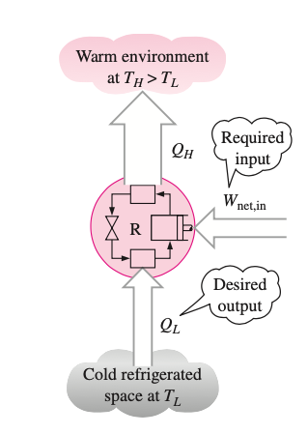
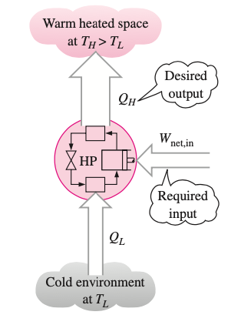
Refrigerator and Heat Pump
Refrigerator
Heat Pump

Slide 21
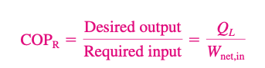
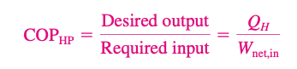
Coefficient of Performance

Slide 22
The Second Law
Clausius statement (1850):
Heat can never pass from a colder to a warmer body without some other change
Kelvin statement (1851):
It is impossible for any device that operates on a cycle to receive heat from a single reservoir and produce a net amount of work
The heat engine efficiency cannot reach 100%.
A heat engine must reject some heat to the surroundings.

Slide 23
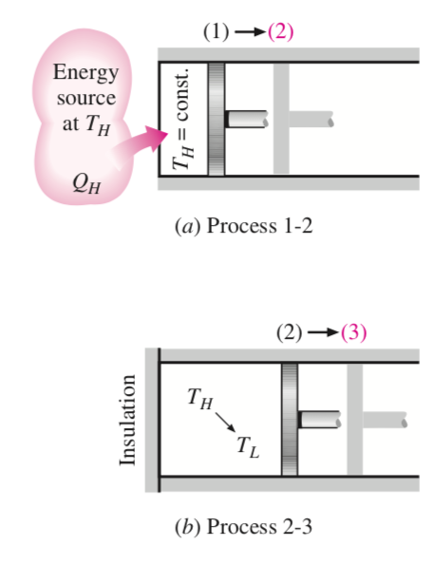
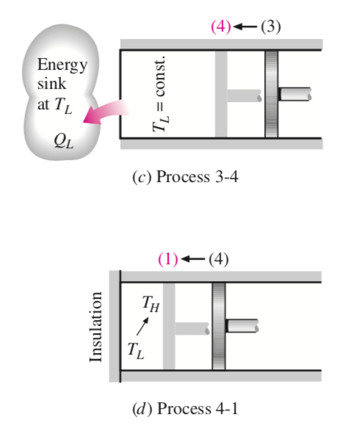
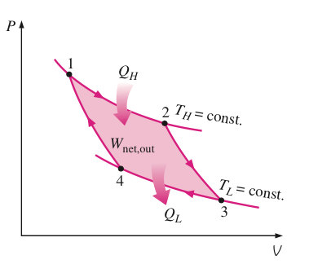
Carnot Cycle
https://www.youtube.com/watch?v=GyEc3P_hBgY

Slide 24
Carnot Cycle
1 to 2: isothermal expansion
2 to 3: adiabatic expansion
3 to 4: isothermal compression
4 to 1: adiabatic compression

Slide 25
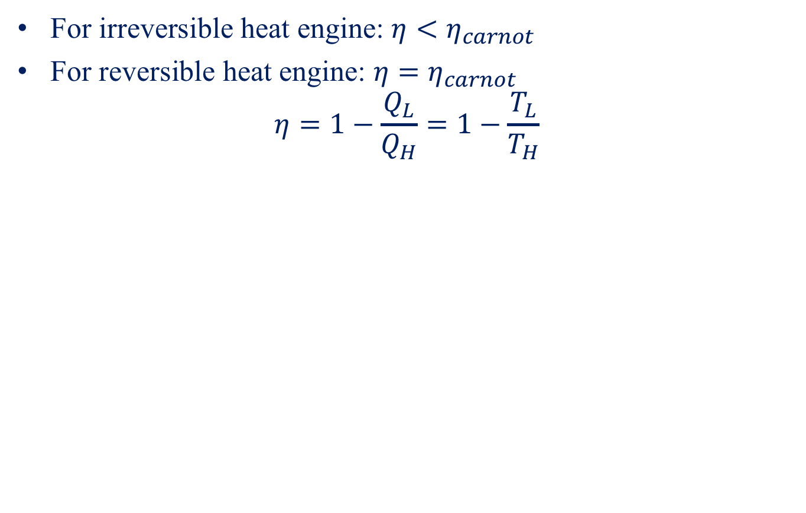
Carnot Theorem
For irreversible heat engine: $η<η_{carnot }$
For reversible heat engine: $η=η_{carnot }$
$$η=1−\frac{Q_{L}}{Q_{H}}=1−\frac{T_{L}}{T_{H}}$$
All reversible engines operating between the same heat reservoir are
equally efficient.

Slide 26
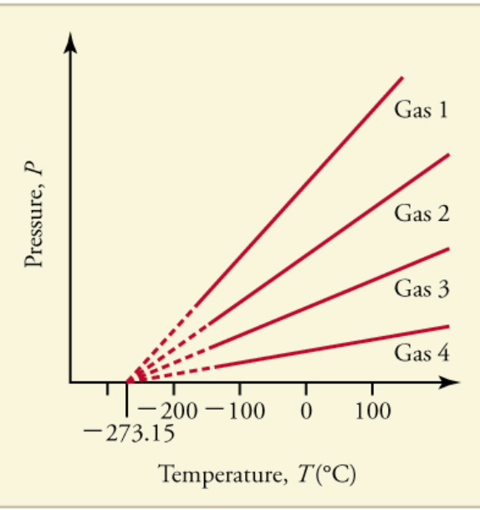
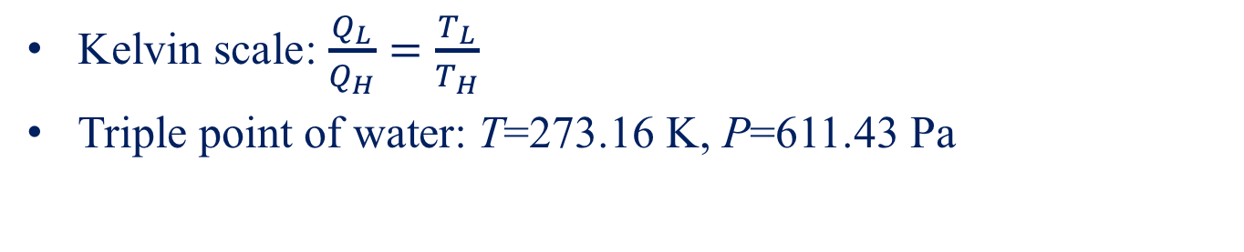
Thermodynamic Temperature Scale
Kelvin scale: $\frac{Q_{L}}{Q_{H}}=\frac{T_{L}}{T_{H}}$
Triple point of water: T=273.16 K, P=611.43 Pa
The temperature ratios depend on the ratios of heat transfer;
Are independent of the substance species.

Slide 27
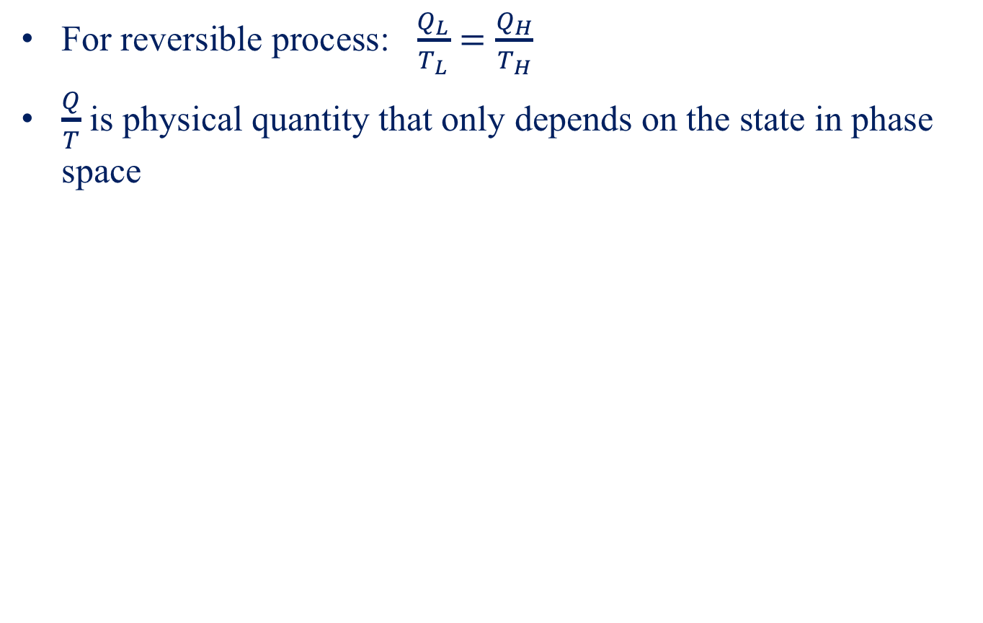
Entropy
For reversible process: $\frac{Q_{L}}{T_{L}}=\frac{Q_{H}}{T_{H}}$
$\frac{Q}{T}$ is physical quantity that only depends on the state in phase space

Slide 28
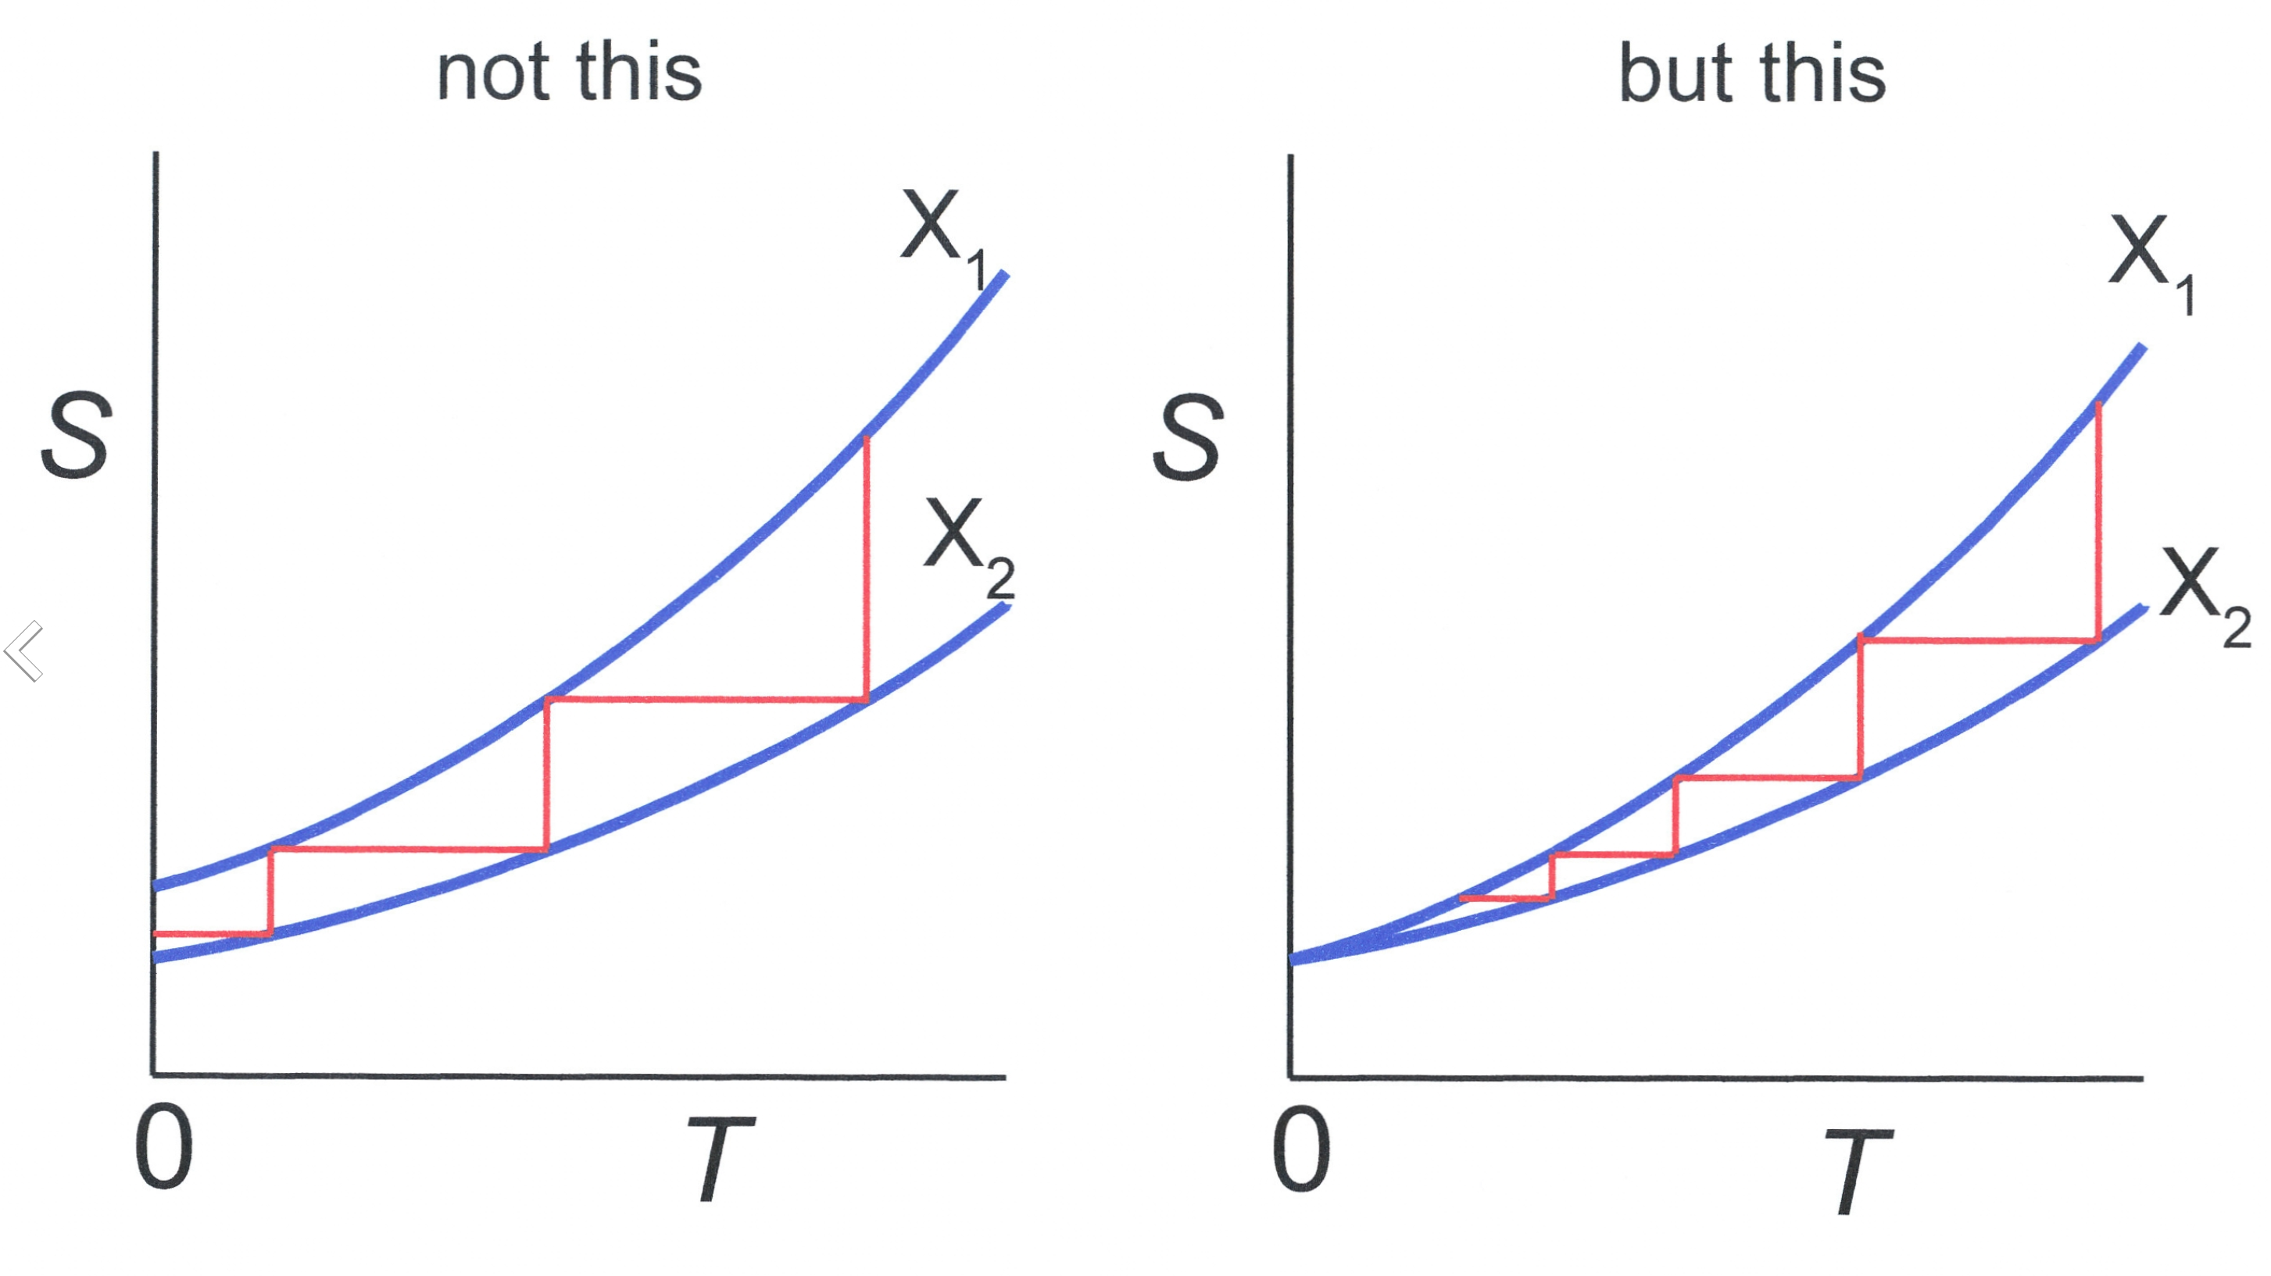
The Third Law
It is impossible for any process, no matter how idealized, to reduce the entropy of a system to its value at absolute-zero temperature in a finite number of operations.
Isentropic process
At 0 K, there is no entropy difference
Infinite steps

Slide 29
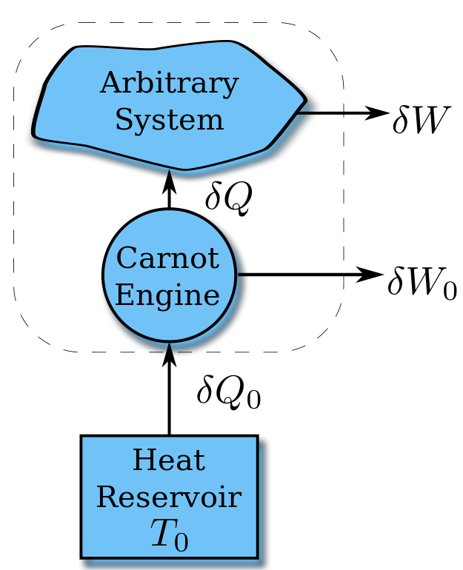
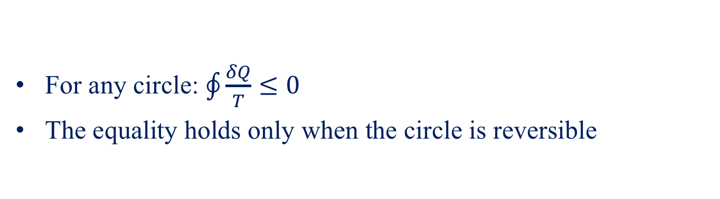
Clausius Inequality
For any circle: $\oint{\frac{δQ}{T}}≤0$
The equality holds only when the circle is reversible

Slide 30
Entropy in Thermodynamics (1865)
For reversible process:
(1) Entropy is a point function.
(2) Entropy change of a irreversible process between two states is the same with a reversible process between the same two states.

Slide 31
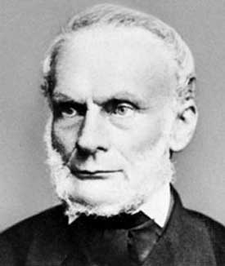
Rudolf Julius Emanuel Clausius
（1822-1888）

Slide 32
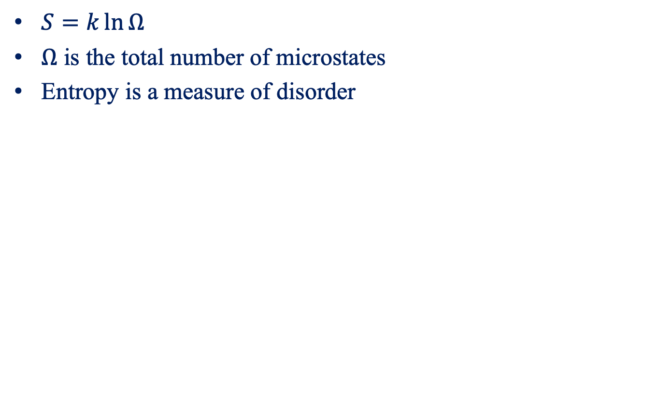
Entropy in Statistical Mechanics (1877)
$S=k\ln{Ω}$
$Ω$ is the total number of microstates
Entropy is a measure of disorder

Slide 33
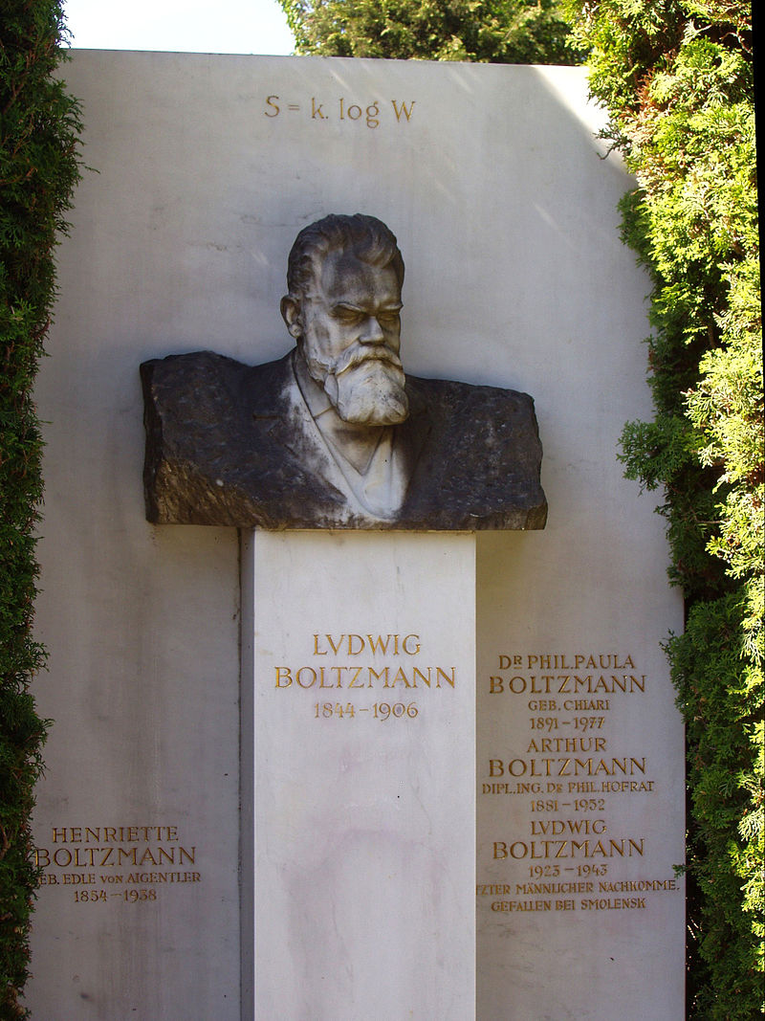
Ludwig Boltzmann(1844-1906)

Slide 34
Entropy in Information Theory (1948)
Entropy is the measure of the amount of information that is missing before reception.

Slide 35
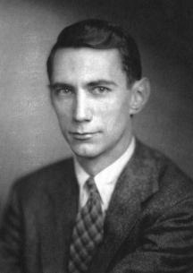
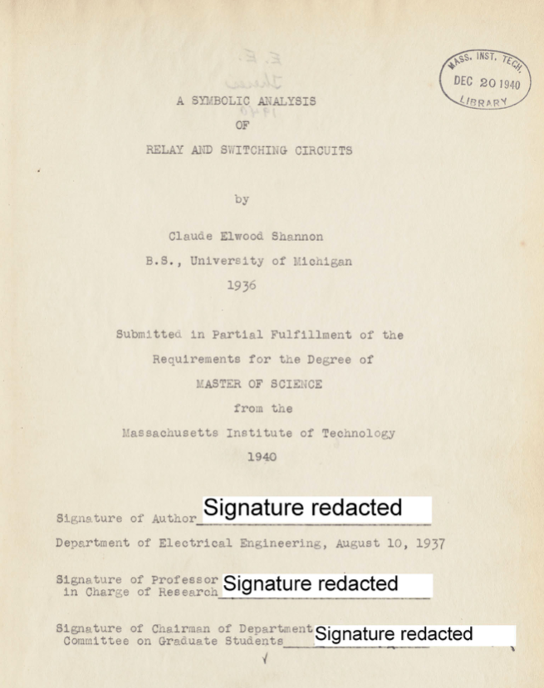
Shannon
Claude Shannon
(1916---2001)
Demonstrating that electrical applications of Boolnean algebra could construct any logical numerical relationship.

Slide 36
The Increase of Entropy Principle
For reversible process:
For irreversible process:

Slide 37
Entropy Generation
Entropy is not conserved
Total entropy change must be positive with any process, with a limiting value of zero for a reversible process
Entropy generation measures the irreversibilites

Slide 38
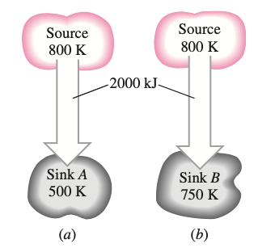
Example

Slide 39

Gibbs Equation
$TdS=dU+pdV$
$TdS=dH−Vdp$

Slide 40


Entropy Change For Ideal-Gas
$$dS_{n}^{id}=C_{v,n}^{id}dT+R\frac{dV_{n}}{V_{n}}$$
$$dS_{n}^{id}=C_{P,n}^{id}\frac{dT}{T}−R\frac{dP}{P}$$

Slide 41


Isentropic Process of Ideal Gas
$\frac{T_{2}}{T_{1}}={\left(\frac{V_{n,1}}{V_{n,2}}\right)}^{\frac{R}{C_{v}}}$

Slide 42
Adiabatic Expansion of Ideal Gas

Slide 43
Entropy Change in Carnot Cycle
p
Q₁
1
2
T₁
4
A
|Q₂|
3
T₂
O
V
V₁ V₄ V₂ V₃

Slide 44



Entropy Balance for Open Systems
$$S_{gen}=ΔS_{sys}+ΔS_{flow}+ΔS_{surr}$$
Entropy balance is defined for both the system and its surroundings.

Slide 45



Reversible steady-flow process
Flow work:
Steady flow: $W=−VΔP−ΔE_{k}−ΔE_{p}$

Slide 46


Example

Slide 47



Ideal Work
Process requiring work: an absolute minimum amount of work is required
Process producing work: an absolute maximum amount of work can be realized
$W_{ideal}=ΔH−T_{s}ΔS$
Producing work
Requiring work

Slide 48

Lost Work
Lost work: work that is wasted as the result of irreversibilities
$W_{lost}=W−W_{ideal}$
$W_{lost}=T_{s}ΔS−Q$
$W_{lost}=T_{s}S_{gen}$
Entropy generation: $S_{G}=ΔS−\frac{Q}{T_{S}}$

Slide 49
Summary points
2nd law
Carnot theorem
Entropy
Entropy generation
Clausius inequality
Entropy change for ideal gas
Ideal work/lost work

